Slide 1
Lecture 1. Genetics (February 18)
Lecture 2: Molecular Genetics (February 18)
Lecture 3 Recent Advances in Plant Breeding (February 19)
Madan K. Bhattacharyya, Ph.D.
Professor, Iowa State University
Adjunct Prof., Assam Agricultural University
mbhattac@iastate.edu

Slide 2
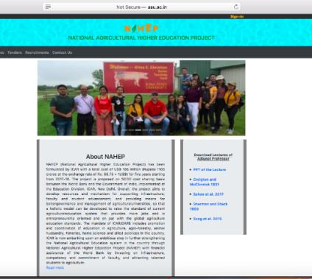
Website for the presentations and papers
http://aau.ac.in/NAHEP/

Slide 3
Lecture 1- Genetics
10:30 to 12:30 PM of February 18, 2020
Meiosis
Recombination
Segregation
Independent Assortment & Linkage
Genetic & Physical Maps
Madan K. Bhattacharyya, Ph.D.
Professor, Iowa State University
Adjunct Prof., Assam Agricultural University
mbhattac@iastate.edu

Slide 4
Lecture 1- Genetics
10:30 to 12:30 PM of February 18, 2020
Meiosis
Recombination
Segregation
Independent Assortment & Linkage
Genetic & Physical Maps
Madan K. Bhattacharyya, Ph.D.
Professor, Iowa State University
Adjunct Prof., Assam Agricultural University
mbhattac@iastate.edu

Slide 5
Meiosis Generates Genetic Variation

Slide 6
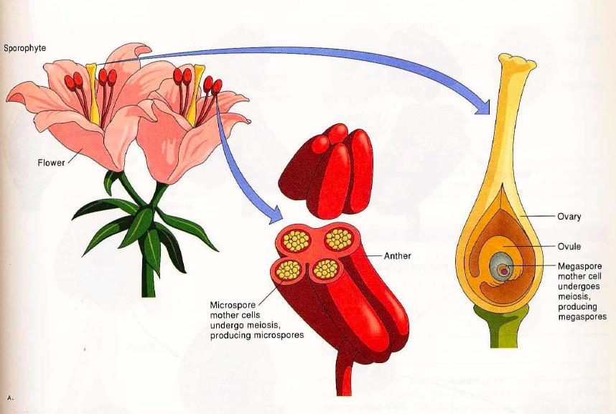
Flowers; where the journey begins for generating genetic variation starts!

Slide 7
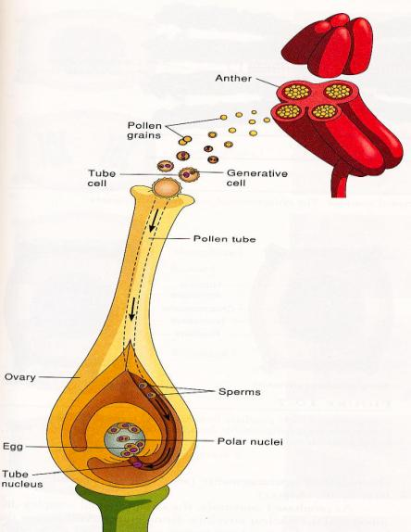
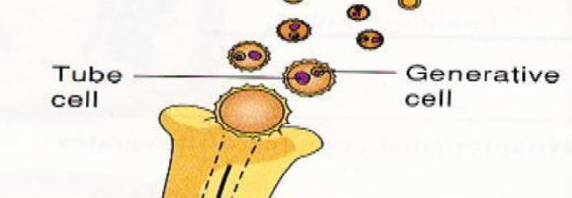
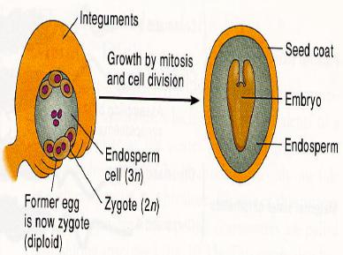

Slide 8
Major differences between Mitosis and Meiosis

Slide 9
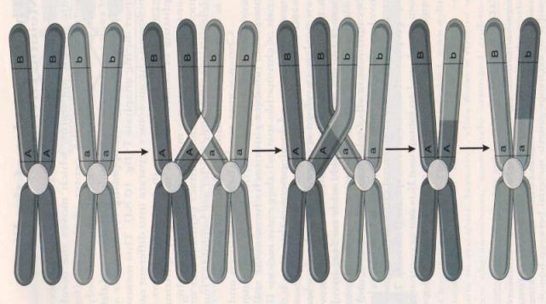
Generation of novel chromatids through crossing over at the end Meiosis I
Equational Separation
Reductional Separation

Slide 10
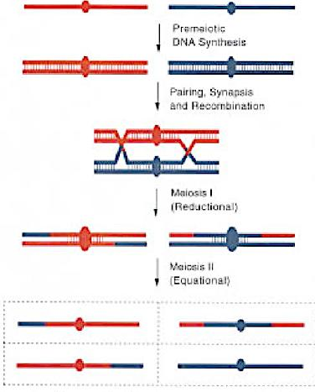
Type of Separations During Meiosis I and Meiosis II: Centromere
Reductional
Equational
Equational
Reductional

Slide 11
Chromosomal Separations in Meiosis
Sister chromatids go to same pole at anaphase I.
The kinetochore ("spindle attachment”) always separates reductionally at anaphase I
A locus some distance from the centromere will separate reductionally or equationally depending on the number of cross-over events between the locus and the centromere.
Thus, a locus separated by one crossover from the centromere will separate equationally at anaphase I and reductionally at anaphase II.
Any plant breeding implications?

Slide 12
Recombination

Slide 13
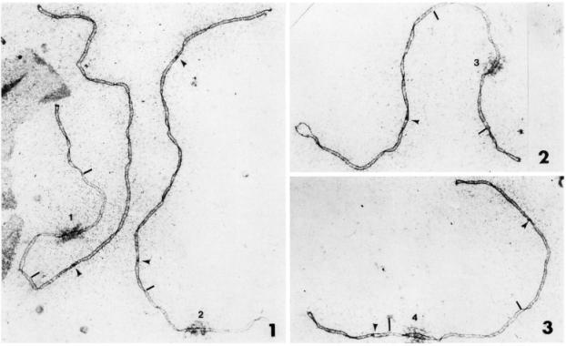
A high-resolution physical recombination map for tomato chromosomes
RN & Chiasmata terminalisation
Recombination Nodules (RN) in Tomato
Sherman and Stack 1995

Slide 14
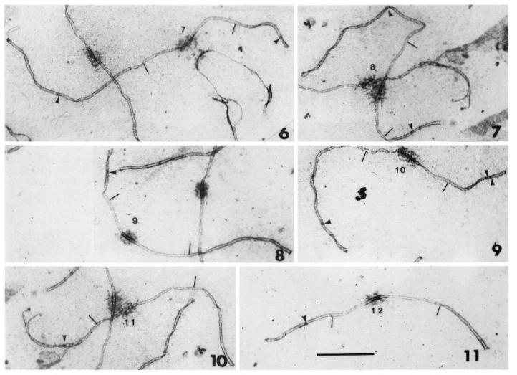

Slide 15
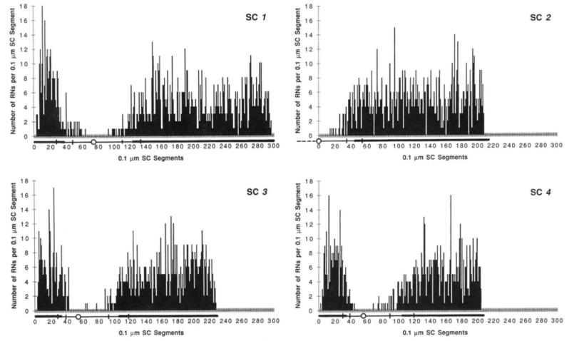
Distribution of RNs on tomato synaptonemal complexes (SCs).
Acrocentric Chromosomes

Slide 16
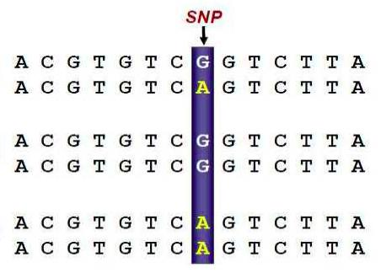
Single Nucleotide Polymorphism (SNP)
Heterozygote
Homozygote
Homozygote

Slide 17
Recombination is suppressed in the heterochromatic region containing the centromere.
Blue line: Williams 82 × PI479752
Red Line: Essex × Williams 82
SNP: single nucleotide polymorphism
Song et al. 2016) BMC Genomics 17:33

Slide 18
Recombination is suppressed in the heterochromatic region containing the centromere.
Blue line: Williams 82 × PI479752
Red Line: Essex × Williams 82
SNP: single nucleotide polymorphism
Song et al. 2016) BMC Genomics 17:33

Slide 19
Different recombination rates across the chromosomes.
Recombination rates are highly suppressed in the heterochromatic regions containing the centromeres.
Genetic and physical maps do not have any linear relationships.
Rare recombination rates in heterochromatic areas depict tight linkages between genes and/or markers. In fact, 10 -100 times more physical distances/cM in heterochromatic regions observed as compared to that in the euchromatic regions.
Any plant breeding implications?

Slide 20
Segregation

Slide 21
Mendel's laws of inheritance
Law | Definition
Law of dominance | Some alleles are dominant while others are recessive; an organism with at least one dominant allele will display the effect of the dominant allele.
Law of segregation | During gamete formation, the alleles for each gene segregate from each other so that each gamete carries only one allele for each gene.
Law of independent assortment | Alleles of genes governing different traits can segregate independently during the formation of gametes.

Slide 22
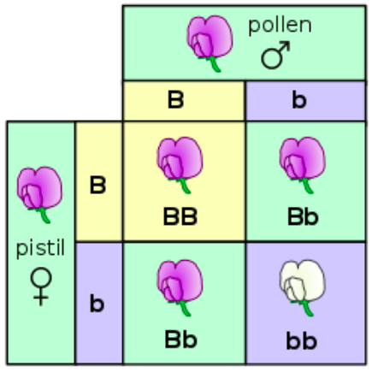
Law of segregation

Slide 23
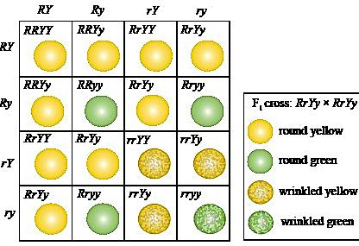
Law of independent assortment
R-Y-:R-yy:rrY-:rryy:: 9:3:3:1

Slide 24
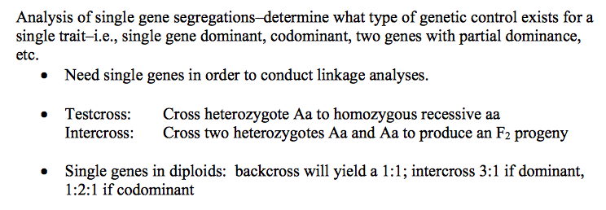
Segregation of genetic loci

Slide 25
Law of segregation

Slide 26
Determine if observed segregation fits any genetic ratio.

Slide 27
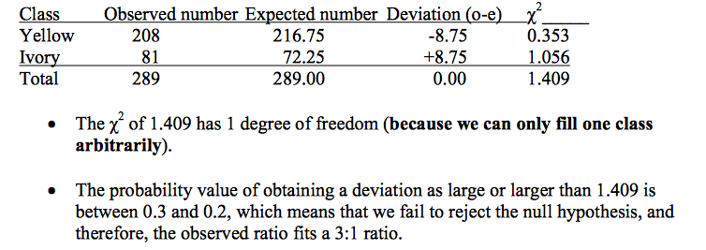
Determine if observed segregation fits any genetic ratio.
Segregation of flower color in Antirrhinum majus.
Null Hypothesis: The observed ratio does not fit the 3:1 ratio.
Alternate Hypothesis: Fits the 3:1 ratio

Slide 28
Segregation of Genetic Loci
Alleles of genetic loci segregates and generates recombinants.
Recombinants are novel genotypes with new combination of genes or alleles.
Some of the recombinants could have desirable alleles in most genetic loci.
Chi-square test allows defining segregating ratios and gene actions.
Any plant breeding implications?

Slide 29
Independent Assortment & Linkage

Slide 30
Independent Assortment & Coupling and Repulsion Phase Linkages
A
Coupling Phase Linkage
A
Repulsion Phase Linkage
B
b
Independent Assortment
> 50 cM
C
C

Slide 31
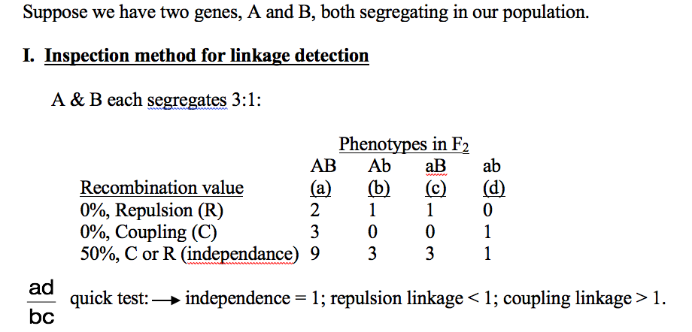
Detection of Linkage
A
a
B
b

Slide 32
Detection of Linkage
A
B
Independent Assortment
> 50 cM
> 50 cM
C

Slide 33
Detection of Linkage: Example
F₂ data for cr (crinkly dwarf) vs. ms (male sterile)
cr-ms x Normal (double mutant was crossed with the wild-type) (coupling phase cross)
a = 181, b = 33, c = 35, d = 30; N = 279
AB (a)
Ab (b)
aB (c)
ab (d)
Quick test: (181 x 30)/(33 x 35) = 4.7 (coupling linkage as > 1).

Slide 34
Independent Assortment and Linkage
Relative positions of two genetic loci determines if independent assortment or linkage will prevail between them.
Coupling and repulsion phase linkages produce different proportions of recombinants; with coupling phase more sensitive in identifying recombination percentage.
Any plant breeding implications?

Slide 35
Genetic & Physical Maps

Slide 36
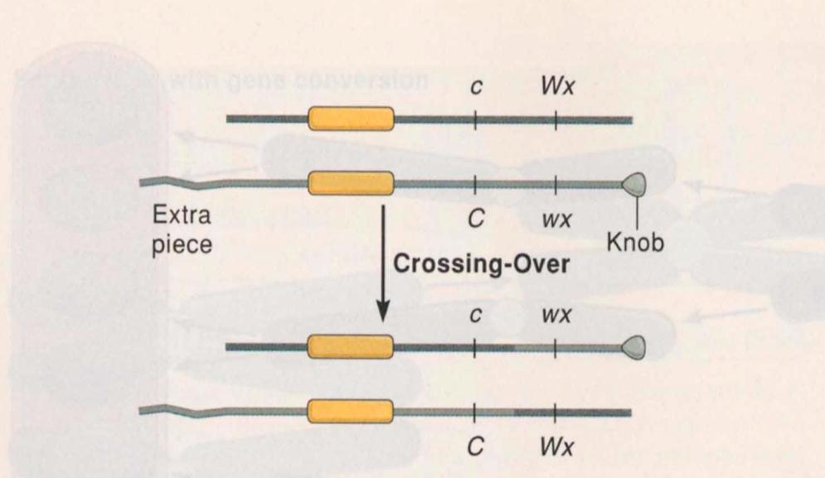
Map of the cytological and morphological markers of maize chromosome 9 based on crossing over frequencies.
Cytological crossing over correlated with the genetic crossing over.
Creighton and McClintock, 1931

Slide 37
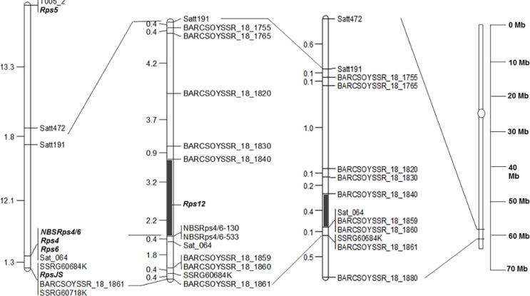
Genetic Map
Physical Map
cM
cM
Mb
Mb
Sahoo DK, Abeysekara NS, Cianzio SR, Robertson AE, Bhattacharyya MK (2017) A Novel Phytophthora sojae Resistance Rps12 Gene Mapped to a Genomic Region That Contains Several Rps Genes. PLOS ONE 12(1): e0169950. https://doi.org/10.1371/journal.pone.0169950
https://journals.plos.org/plosone/article?id=10.1371/journal.pone.0169950

Slide 38
Genetic and Physical Maps
Genetic map is based recombination percentage.
Physical map denotes actual physical distances in Kb (1,000 base pairs) or Mb (1 million bp) units.
Relationship between the two maps varies across a chromosome; with more crossing overs in the euchromatic regions and much reduced in the heterochromatic regions.
1 cM could be around 100 Kb or less in euchromatic regions; whereas, ~1-4 Mb in the heterochromatic regions.
Any plant breeding implications?

Slide 39
Let’s discuss more!

Slide 41
Metacentric Chromosomes
Metacentric chromosomes have the centromere in the center, such that both sections are of equal length.
Submetacentric Chromosomes
Submetacentric chromosomes have the centromere slightly offset from the center leading to a slight asymmetry in the length of the two sections.
Acrocentric Chromosomes
Acrocentric chromosomes have a centromere which is severely offset from the center leading to one very long and one very short section.
Telocentric Chromosomes
Telocentric chromosomes have the centromere at the very end of the chromosome.

Slide 43
Lecture time: 4 to 6 PM
Lecture 1. Genetics (February 3)
Lecture 2: Molecular Genetics (February 5)
Lecture 3: Molecular Markers and Molecular Breeding (February 7)
Lecture 4: Transgenic Technology (February 10)
Lecture 5: Gene editing using CRISPR Cas Technology (February 12)
Lecture 6: Recent Advances in Plant Breeding (February 14)
Madan K. Bhattacharyya, Ph.D.
Professor, Iowa State University
Adjunct Prof., Assam Agricultural University
mbhattac@iastate.edu

Slide 44
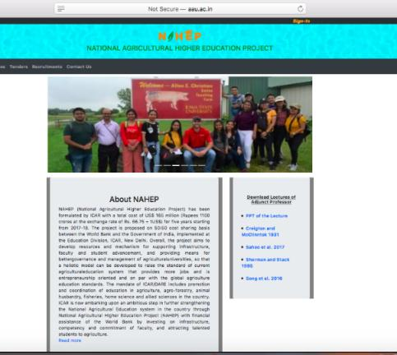
Website for the presentations and papers
http://aau.ac.in/NAHEP/

Slide 45
Lecture 2 - Molecular Genetics
4 to 6 PM of February 5, 2020
Gene structure
Transcription
Translation
Central dogma
Metabolites and metabolic pathway
Molecular basis of phenotypes

Slide 46
Gene Structure

Slide 47
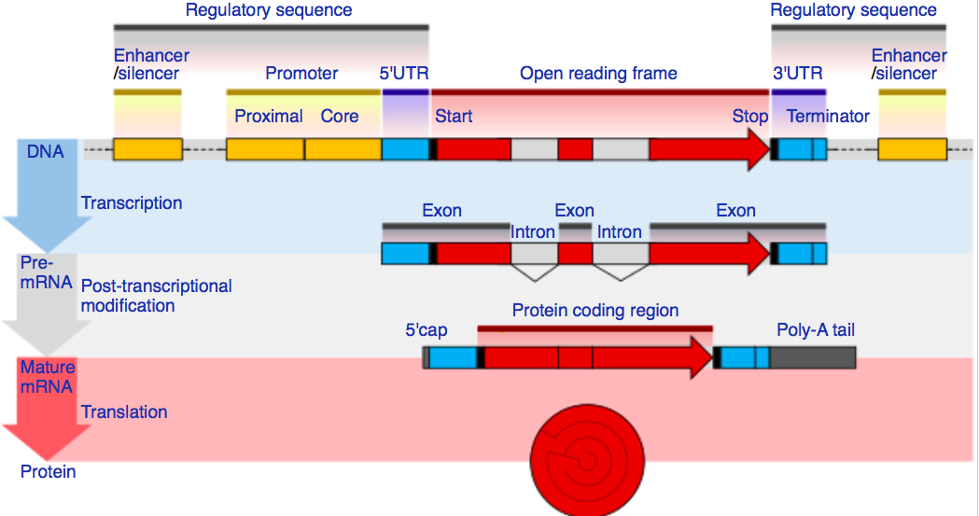
Gene Structure in Eukaryotes

Slide 48
Transcription

Slide 49
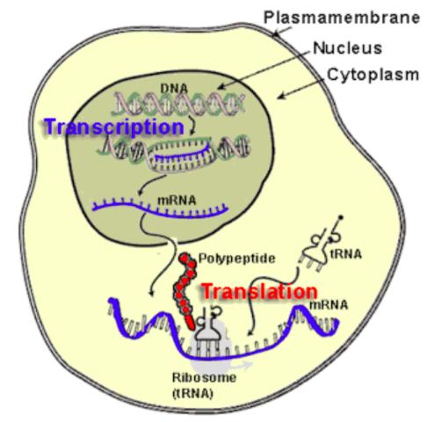
Transcription in an Eukaryotic Cell

Slide 50
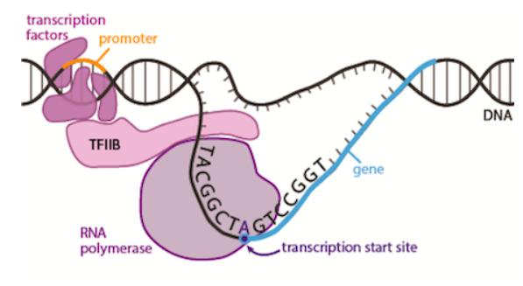
Transcription

Slide 51
Transcription

Slide 52
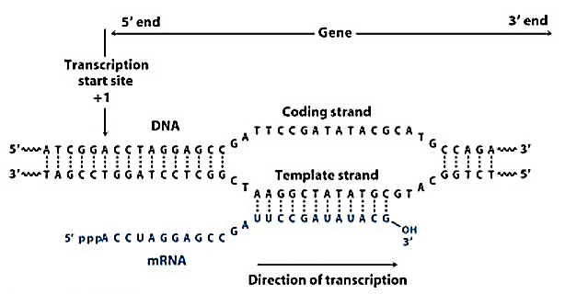
Transcription

Slide 53
Translation

Slide 54
Translation in an Eukaryotic Cell

Slide 55
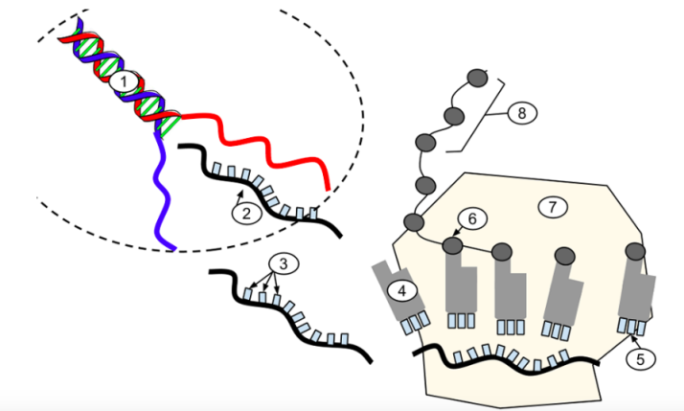
Translation

Slide 56
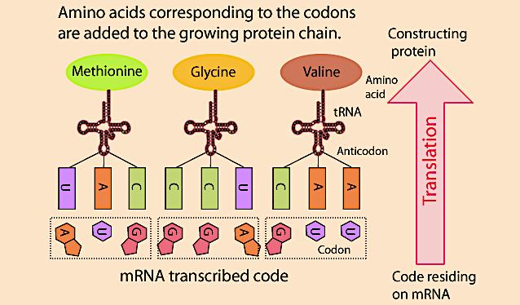
Translation

Slide 57
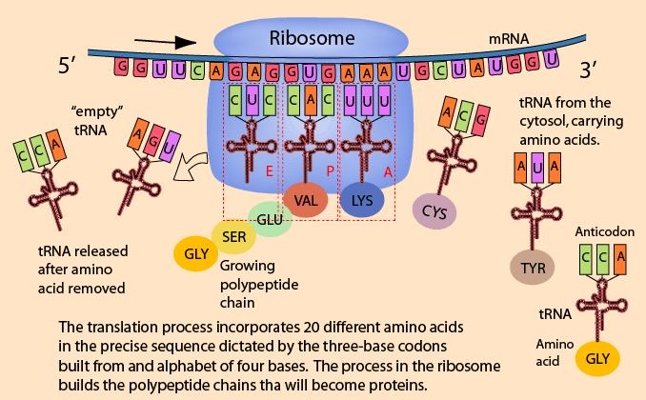
Translation

Slide 58
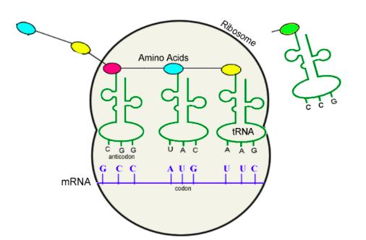
Translation

Slide 59
The Central Dogma in Molecular Biology

Slide 60
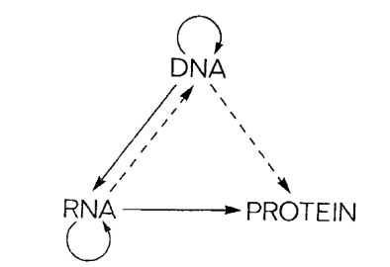
The central dogma of molecular biology is an explanation of the flow of genetic information within a biological system.
Francis Crick (1958, 1970)
“The central dogma of molecular biology deals with the detailed residue-by-residue transfer of sequential information. It states that such information cannot be transferred from protein to either protein or nucleic acid.”
Francis Crick (1970)

Slide 61
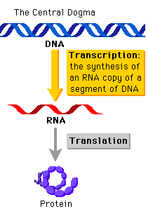
The central dogma of molecular biology is an explanation of the flow of genetic information within a biological system.
Jim Watson (1965) in the first edition of The Molecular Biology of the Gene described this simple version.

Slide 62
What is a gene?
The first mention of gene was made by Mendel.
He explained his results in terms of discrete inherited units (now known as genes) that give rise to observable physical characteristics.
In 1905, Johannsen introduced the term 'gene' and in 1908, Bateson termed genetics.
Today you have learned that a gene, a DNA segment, contains information for a protein that mediates gene-function.
This is the central dogma of molecular biology "DNA makes RNA and RNA makes protein.”

Slide 63
We now know much more than 1950s or 1960s!
Is the central dogma still relevant?

Slide 64
Not really – some of the exceptions are listed below:
Same gene may have splice variants with distinct regulatory functions; e.g. tobacco N gene encoding TMV resistance
Multiple subunits of an enzyme could be encoded by a number of genes.
t-RNA genes for t-RNAs involved in protein synthesis.
snRNA genes for snRNAs involved in splicing pre-mRNAs.
Ribosomal genes for rRNAs involved in protein synthesis.
Micro-RNAs with regulatory functions.

Slide 65
Metabolites and Metabolic Pathway

Slide 66
Metabolites are closest to phenotypes
Genes
mRNAs
Proteins
Metabolites
Phenotypes

Slide 67
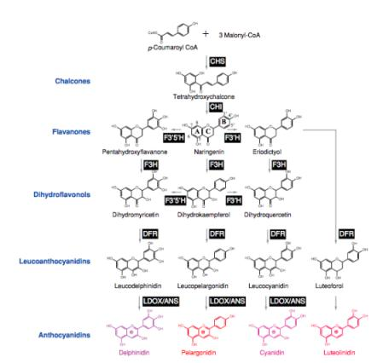
Biosynthetic pathway of four major classes of anthocyanins
Biosynthesis of the 4 major classes of anthocyanins (Grotewold, 2006). Names of compounds are indicated and enzymes, in black boxes, are as follows: CHS, chalcone synthase; CHI, chalcone isomerase; F3H, flavanone 3-hydroxylase; F3’H, flavanone 3’-hydroxylase; F3’,5’H, flavanone 3’,5’-hydroxylase; DFR, dihydroflavonol 4-reductase; LDOX/ANS, leucoanthocyanidin dioxygenase/anthocyanidin synthase. Grotewold E. 2006, Annu. Rev. Plant-Biol. 57:761-80.

Slide 68
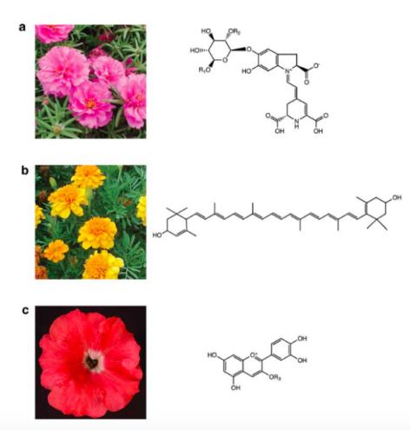
Metabolites provide the petal color phenotypes.
Flower displaying the three major types of pigments and the corresponding structures.
(a) Portulaca (Portulaca grandiflora) flowers accumulating primarily the betalain pigment, betanin (R1 = R2 = H).
(b) Marigold (Tagetes patula) flowers accumulating the carotenoid pigment, lutein.
(c) Petunia (Petunia hybrida) flower accumulating an anthocyanidin, cyanidin.
Grotewold E. 2006, Annu. Rev. Plant-Biol. 57:761-780

Slide 69
Molecular Basis of Phenotypes

Slide 70
Wrinkled Pea Seed
Variegated Soybean Flower

Slide 71
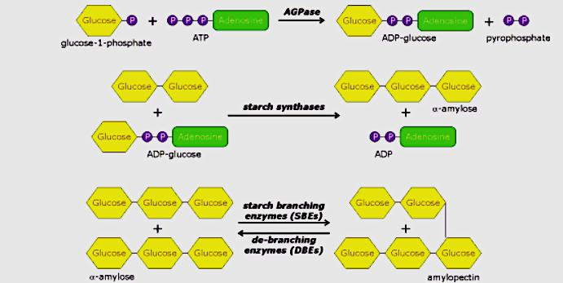
Starch Biosynthetic Pathway

Slide 72
Starch Biosynthetic Pathway in r Pea Mutant
40% to 65%
X
45% to 32%

Slide 73
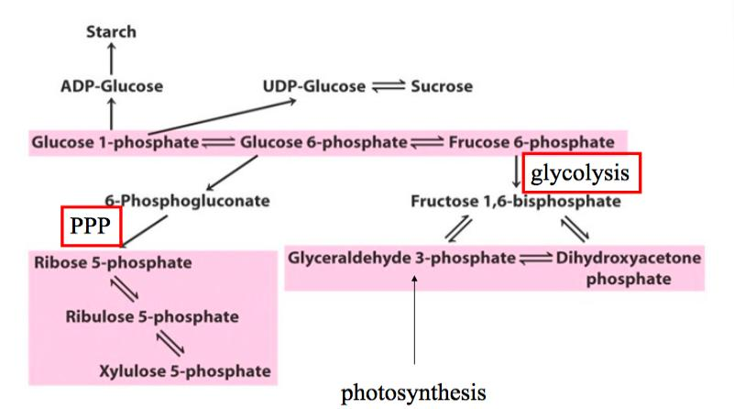
The r pea mutant
10% from 6% in Sweet Peas

Slide 74
Starch Branching Enzyme I is Impaired in the r Pea Mutant
40% to 65%
X
45% to 32%

Slide 75
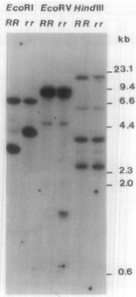
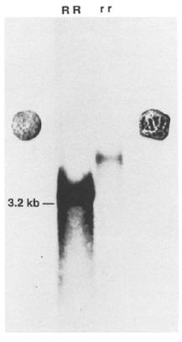
A transposon-like insertion caused mutation in a starch branching enzyme gene located in the r locus studied by Gregor Mendel.
DNA blot
RNA blot
Southern blot
Northern blot
Bhattacharyya et al. 1990

Slide 76
How does wrinkled seed phenotype develop in the r mutant?
Lack of SBEI
Low Amylopectin and High Amylose
Sugars Increased from ~ 6 to 10%
Increased Osmotic Potential
Higher Water Uptake During Seed Development
Cell Shrinking During Seed Maturation
Wrinkled Seeds
Bhattacharyya et al. 1993

Slide 77
Variegated Flower Phenotype

Slide 79
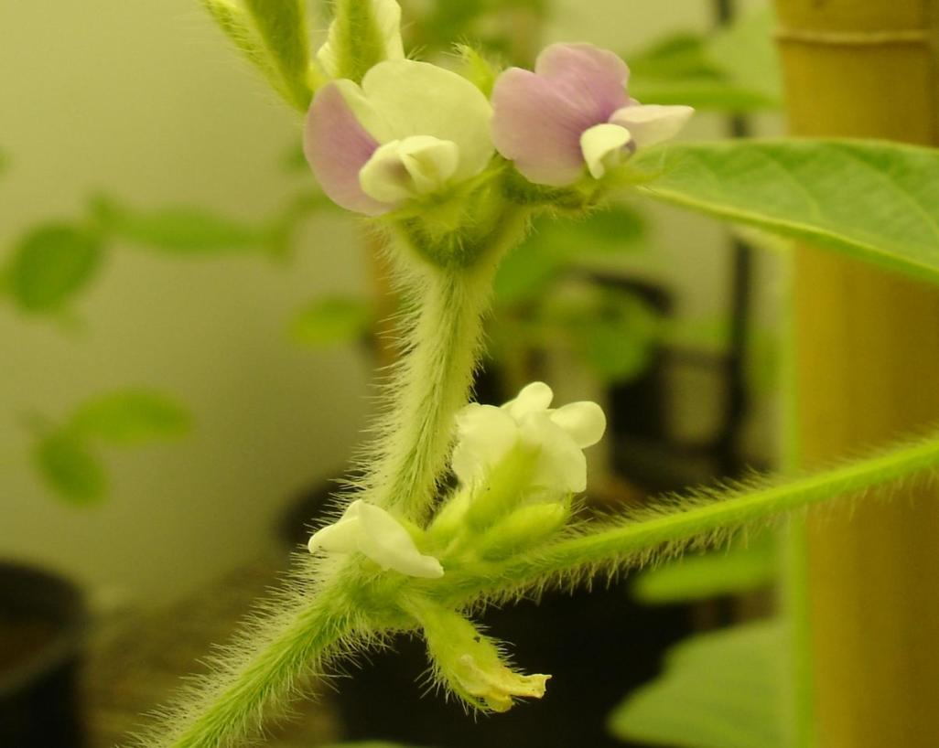

Slide 81
The W4 locus
+
p-Coumaroyl-CoA
3 x Malonyl-CoA
CHS
Chalcone
CHI
Naringenin
Flavanone 3-hydroxylase (Wp)
F3’H
F3’5’H
Dihydroquercetin
Dihydrokaempferol
Dihydromyricetin
(Dihydroflavonols)
Flavonol synthase
Flavonol synthase
Flavonol synthase (Wm)
Quercetin
Kaempferol
Myricetin
(Flavonols)
Dihydroflavonol-4-reductase (DFR) (W3,W4)
Dihydroflavonol-4-reductase (DFR) (W3)
Dihydroflavonol-4-reductase (DFR) (W3, W4)
Leucocyanidin
Leucopelargonidin
Leucodelphinidin
(Leucoflavonols)
Anthocyanidin synthase
3-glucosyl transferase
Anthocyanidin synthase
3-glucosyl transferase
Anthocyanidin synthase
3-glucosyl transferase (ANS)
Cyanidin-3-glucoside
Pelargonidin-3-glucoside
Delphinidin-3-glucoside
(Anthocyanins)
Xu et al. 2010
Notes:
81

Slide 82
A CACTA-type Transposable Element Tgm9 in the DFR2 Intron II causes loss of DFR2 function in Soybean.
TATA box
CTAAGGCGGTTATAAATAACCATCTTAGTAACTCGCTGGGTGGCATTTTT
ATG
TAA
ATG
TAA
Tgm9 (20,548 bp)
1
2
3
4
5
6
8
9
10
11
12
14
18
7
13
20
15
16
17
19
21
22
23
24
25
26
27
ORF1
(GmTNP2)
ORF2
(GmTNP1)
Truncated Tgm9
(1354 bp)
ATT
Identical
Xu et al. 2010
Notes:
82

Slide 85
What have you learned today?
With new knowledge about genes available, the central dogma became irrelevant.
Despite the information flow from DNA to RNA and then RNA to protein is universal; there are many exceptions discovered in later years.
Gene does not work alone. A gene is a team player; work in a group. As you have seen, mutation in a single gene can have profound effect on phenotype.
Wrinkled seed shape and sweetness in sweet peas are the result of a mutation in a starch branching enzyme gene leading to reduced amylopectin and increased amylose as well as sucrose contents.
Variegated flowers in soybean is induced by excision of Tgm9 from the DFR2 gene, a member of the group of genes that control the anthocyanin biosynthetic pathway.

Slide 86
Plant Breeding Implications
Traits are governed by a large number of genes. Genes we target to breed in are usually regulatory genes that control the entire pathway.
Disease resistance (R) genes are a good example. R genes are single genes; they however need a large number of genes to manifest the resistance.
Two metabolic pathways shown here also show how structural genes are important in manifesting phenotypes.
Mutants are the keys to studying the phenotypes.
Metabolic markers are better predictors of phenotypes. Why not apply?
Metabolite panels are used to check our health!

Slide 87
Let’s talk about the things that you are not clear!

