Slide 1
Lecture 3: Molecular Markers and Molecular Breeding (February 7)
  Southern Blotting
  PCR
  Recombinant DNA Technology
  Sequencing Technologies
Molecular Markers
Rapid Identification of Linked Markers
Molecular-assisted Breeding

Slide 2
Southern Blotting

Slide 3
EcoRI : GAATTC
CTTAAG

Slide 7
RFLP gel showing DNA fragment length polymorphisms.

Slide 8
Polymerase Chain Termination Reaction (PCR)

Slide 9
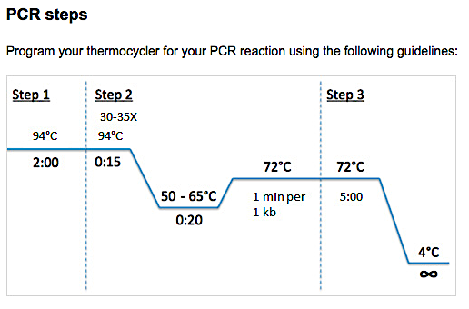

Slide 10
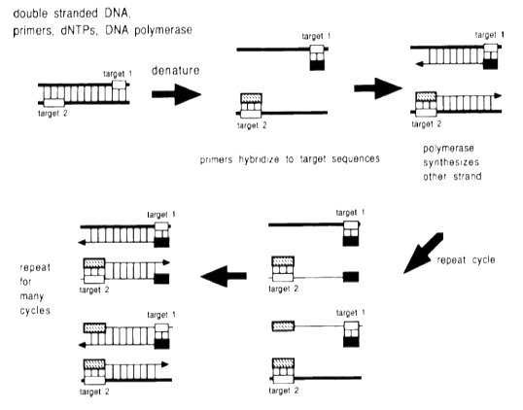

Slide 11
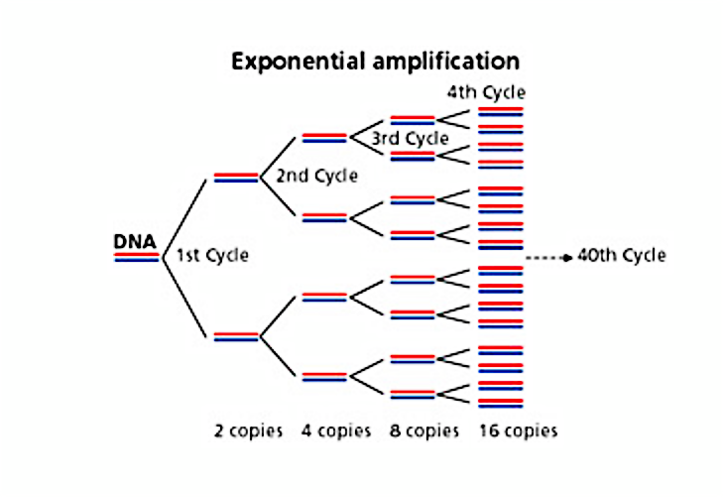

Slide 13
Recombinant DNA Technology

Slide 14
Plasmid (circular) and Lambda (linear) vectors for cloning DNA fragments.
Cut & Paste
Cut with restriction endonucleases: say EcoRI which cuts the GAATTC palindromic site.
Same enzyme can be used to digest both the vector or DNA molecules so that DNA fragments will be compatible with the cut site released in the vector.
Then ligate the molecules with T4 DNA ligase to paste the DNA fragments with the vector before transforming E. coli.

Slide 15
Complementary DNA (cDNA) molecules from mRNAs for cloning

Slide 16
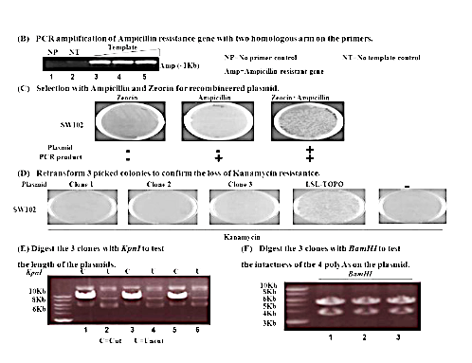
Cloning DNA fragments
Vector
Insert

Slide 17
Double digestion (DD) of PCR products (Insert for Cloning)
Afl1I
XbaI
293bsp
20bsp
1184bsp
4bsp
195bsp
XbaI UD AflII DD
Insert before digestion: 1,696 bp
Insert after digestion: 1,399 bp

Slide 18
Double digestion of pHSE401 vector with XbaI and AflII
AflII
XbaI
< 2.7kb
UD 1 2 3
Vector
2.7 kb undesirable fragment

Slide 19
Colony PCR-MYB42g2-2
L A1 A2 A3 M2-1 M2-2 M2-3 M2-4 M13
Sequence the clone just to make sure that there is no error.
1696
Using the green forward and reverse primers cloned inserts in E. coli were evaluated.
AflII
XbaI
293bsp
20bsp
1184bsp
4bsp
195bsp

Slide 20
Sequencing DNA

Slide 21
Sanger’s Dideoxy DNA-Sequencing Procedure

Slide 22
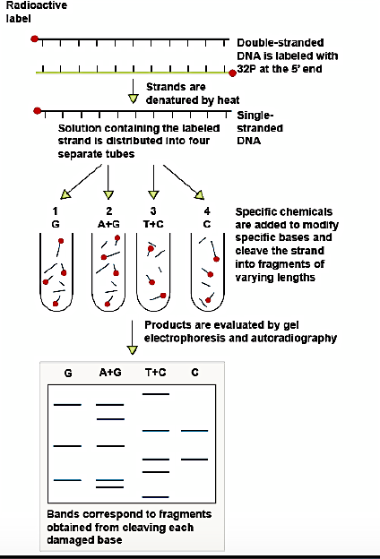
Maxam & Gilbert DNA-Sequencing Procedure

Slide 23
NextGen Sequencing DNA
2nd gen: Ilumina: https://www.youtube.com/watch?v=fCd6B5HRaZ8
3rd Gen: Single Molecule Real Time (SMRT®) http://www.pacificbiosciences.com
3rd Gen: Oxford Nanopore: https://www.youtube.com/watch?v=CGWZvHIi3i0
https://www.youtube.com/watch?v=mI0Fo9kaWqo
Watch this one for a complete review of all important sequencing technologies just in ~31 min. above

Slide 24
Molecular Markers

Slide 25
Some of the popular markers
RFLP: Restriction Fragment Length Polymorphism
RAPD: Random Amplified Polymorphic DNA
SSR: Simple Sequence Repeat
AFLP: Amplified Fragment Length Polymorphism
SNP: Single Nucleotide Polymorphism
GBS: Genotype by Sequencing
CAPS: Cleaved Amplified Polymorphic Sequences
SBP: Sequenced-based Polymorphic marker

Slide 26
Restriction Fragment Length Polymorphism (RFLP)

Slide 27
Sources of RFLPs

Slide 28
RFLPs among three Arabidopsis ecotypes

Slide 29
Segregation of two RFLP markers in F₃

Slide 30
RFLP linkage map in Arabidopsis ecotypes

Slide 31
Random Amplified Polymorphic DNA (RAPD)

Slide 32
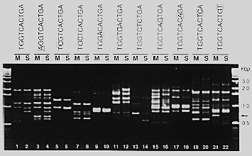
Random Amplified Polymorphic DNA (RAPD)
A single 10 nucleotide oligo anneal in opposite orientation and amplifies DNA.

Slide 33
Simple Sequence Repeat (SSR)

Slide 34
Two SSR alleles differing in repeat numbers produce PCR products that can be separated on an agarose gel.

Slide 35
SSR markers are usually co-dominant.

Slide 36
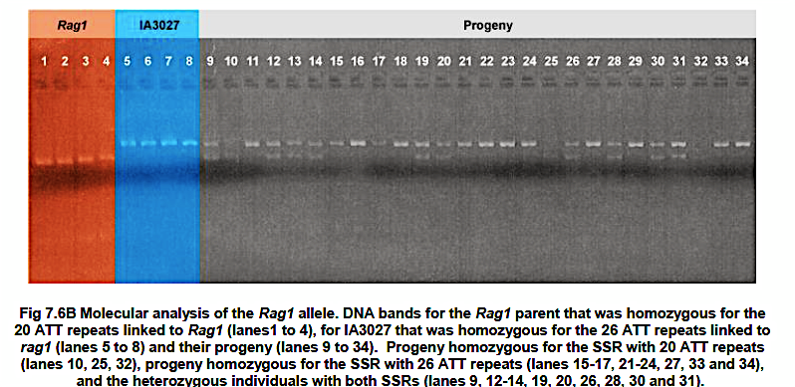
Lane 10 and 25 carry the allele linked to the soybean aphid resistance Rag1 gene in homozygous condition.

Slide 37
SSR: Type and their frequencies in rice
P1: CGGCGGCGGCGGCGGCGGCGGCGGCGGCGGCGGCGG
P2: CGGCGGCGGCGGCGGCGGCGG (15 nt shorter)
Miah et al. 2013

Slide 38
Miah et al. 2013

Slide 39
AFLP: Amplified Fragment Length Polymorphism

Slide 40
AFLP Technology
EcoRI
MseI
EcoRI
MseI

Slide 41
An AFLP Gel: Radio active label is used to detect the PCR amplified fragments.

Slide 42
Single Nucleotide Polymorphism (SNP)

Slide 43
Types of single-nucleotide polymorphism (SNPs)

Slide 44
An example of SSR marker
Heterozygote
Homozygote
Homozygote

Slide 45
Genotype by Sequencing

Slide 47
CAPS: Cleaved Amplified Polymorphic Sequences

Slide 48
Cleaved Amplified Polymorphic Sequences

Slide 49
SBP: Sequenced-based Polymorphic marker

Slide 50
Comparison of sequences from two Arabidopsis ecotypes.

Slide 51
SBP Markers that are polymorphic between Columbia -0 and Neiderzenz ecotypes.

Slide 52
Rapid Identification of Linked Molecular Markers

Slide 53
Bulked segregant Analysis
Michilemore et al. 1991

Slide 56
BSA in Soybean for the Rps1-k gene
Kasuga et al. 1997

Slide 57
AFLP mapping of a marker CC1 linked to Rps1-k.

Slide 58
Mapping the Rps1-k gene that confers Phytophthora resistance in soybean
Kasuga et al. 1997

Slide 59
SHORE mapping to identify genetic loci (BSA)

Slide 60
Molecular marker assisted selection or breeding

Slide 61
Molecular marker linked tightly to the fruit size trait.

Slide 63
Marker-assisted backcrossing

Slide 64
Discussion
What do we need for marker assisted selection?

