Slide 1
Lecture time: 4 to 6 PM
Lecture 1. Genetics (February 3)
Lecture 2: Molecular Genetics (February 5)
Lecture 3: Molecular Markers and Molecular Breeding (February 7)
Lecture 4: Transgenic Technology: Methods (February 10)
Lecture 5: Engineering Traits (February 12)
Lecture 6: Recent Advances in Plant Breeding (February 14)
Madan K. Bhattacharyya, Ph.D.
Professor, Iowa State University
Adjunct Prof., Assam Agricultural University
mbhattac@iastate.edu

Slide 2
Meeting Time: 4 - 6 pm of February 21 and 28 (Fridays)
Website for the presentations and some of the resources used
http://aau.ac.in/NAHEP/

Slide 3
Lecture 5: Engineering Traits (February 12)
Cross Protection
Gene Silencing
Host-induced Gene Silencing
Gene Editing
Overexpression of Genes

Slide 4
Lecture 5: Engineering Traits (February 12)
Cross Protection
Gene Silencing
Host-induced Gene Silencing
Gene Editing
Overexpression of Genes

Slide 5
Expression of the TMV CP Protected tobacco from TMV infection

Slide 6
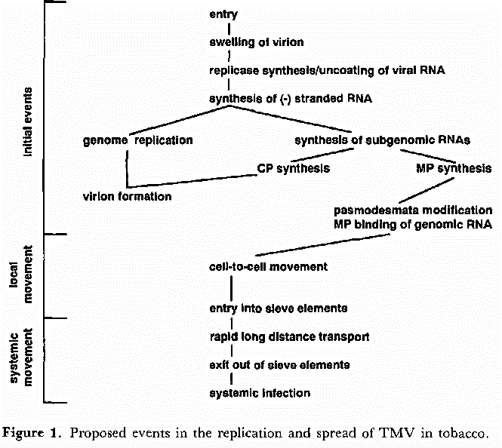
Possible Mechanism
Inhibition of virion disassembly by direct coat protein effect.
For multiplication of the invading TMV molecules, the viral RNA must be unwrapped from the capsid made of coat proteins.
As soon as the RNA molecules are released to the cell cytoplasm for replication, the coat proteins generated from the the transgene start to wrap up the RNA molecules – no replication – no increase in the number of the virus particles.
Reimann-Philipp and Beachy 1993

Slide 7
Transgenic Virus Resistant Papaya
Papaya ringspot virus (PRSV) caused serious devastation to the papaya industry in Hawaii during the early 1990s. Infection by PRSV results in systemic rotting and wilting along with yellow spots and loss of chlorophyll.
To address the PRSV problem, Fitch et al. (1992) developed PRSV resistant transgenic papaya over expressing the PRSV CP gene. The intervention to rescue the papaya industry in Hawaii demonstrates that transgenic virus resistance is a useful approach for controlling viral diseases in horticultural crops.

Slide 8
Fitch et al. 1992

Slide 9
Lecture 5: Engineering Traits (February 12)
Cross Protection
Gene Silencing
Host-induced Gene Silencing
Gene Editing
Overexpression of Genes

Slide 10
Discovery of RNAi and gene silencing
In the early 1990s, Richard Jorgensen and co-workers in an attempt to increase flower pigmentation in petunia by transgenic approaches, they observed that overexpression of transgenes did not deepen pigmentation. Instead, they observed flowers that showed variegated pigmentation, with some lacking pigments altogether as show below.

Slide 11
The researchers concluded that the transgenes and endogenous sequences homologous to the transgenes must have been inactivated, a process they coined co-suppression (Napoli et al., 1990).
Other laboratories later found that plants respond to RNA viruses by destroying viral RNAs to prevent viral genes from being expressed inside plant cells and cause disease.
Co-suppression and viral RNA targeting processes in plant cells are referred to as post-transcriptional gene silencing (PTGS).
RNA interference (RNAi) is a natural mechanism for moderating gene expression in the cells of all eukaryotic organisms from plants to humans.
Although researchers working with worms received full credit for the discovery of RNAi (Fire et al., 1998), related phenomena had been previously observed in plants (Napoli et al., 1990).

Slide 12
Fire et al. 1998
“To our surprise, we found that double-stranded RNA was substantially more effective at producing interference than was either strand individually. After injection into adult animals, purified single strands had at most a modest effect,
whereas double-stranded mixtures caused potent and specific interference. The effects of this interference were evident in both the injected animals and their progeny. Only a few molecules of injected double-stranded RNA were required per affected cell, arguing against stochiometric interference with endogenous mRNA and suggesting that there could be a catalytic or amplification component in the interference process.”

Slide 13
Please watch this Nature Video:
https://www.youtube.com/watch?v=cK-OGB1_ELE

Slide 14
Mechanism of Action of Post-Transcriptional Gene Silencing
PTGS in plants is an RNA-degradation mechanism, similar to RNA interference (RNAi) in animals.
RNAi refers to RNA-mediated regulation of gene expression - decreased expression, or silencing through:
transcriptional silencing,
translational silencing, or
mRNA degradation.
These processes are mediated by small RNAs that target mRNA or chromosomal genes through sequence homology.
The formation of small interfering RNA (siRNAs) or micRNA (miRNAs) is initiated by the formation of double-stranded RNA (dsRNA) molecules which are processed by dicer endonucleases to form the small RNAs of 21-24 nucleotides.
Small RNAs then associate with a protein complex called RISC (RNAi silencing complex) and target cellular mRNAs with homologous sequences resulting in the degradation of the endogenous transcripts.

Slide 15
Knockdown of MLO genes reduces susceptibility to powdery
mildew in grapevine
Pessina et al. 2016

Slide 16
Lecture 5: Engineering Traits (February 12)
Cross Protection
Gene Silencing
Host-induced Gene Silencing
Gene Editing
Overexpression of Genes

Slide 17
Host Induced Gene Silencing
Schematic presentation of possible in planta-induced transient gene silencing (PITGS) mechanisms by which siRNA molecules generated in host cells could be delivered into fungal cells – adapted from Panwar et al. 2013.

Slide 18
Host-induced gene silencing of cytochrome P450 lanosterol C14α-demethylase encoding genes confers strong resistance to Fusarium species

Slide 19
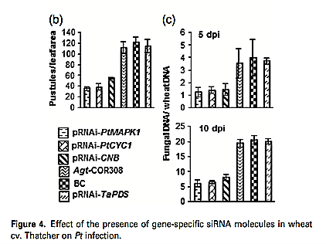
Endogenous silencing of Puccinia triticina pathogenicity genes through in planta expressed sequences leads to the suppression of rust diseases on wheat
Panwar et al. 2013

Slide 20
Lecture 5: Engineering Traits (February 12)
Cross Protection
Gene Silencing
Host-induced Gene Silencing
Gene Editing
Overexpression of Genes

Slide 21
Gene Editing
TALENs
CRISPR-Cas9

Slide 22
Transcription activator–like (TAL) effector nucleases (TALENs)
It is based on discovery in plant pathology. Transcription activator–like (TAL) effectors of plant pathogenic bacteria regulate host gene expression to cause susceptibility. TAL factors carry tandem, polymorphic amino acid repeats that individually specify contiguous nucleotides in DNA as target for binding. The code of effector amino acid sequence binding to specific host DNA sequence in promoters were discovered and applied in TALEN technology.
TAL factors carry repeats of amino acids that recognize nucleic acid in a consistent pattern. Once this was known, it was feasible to design artificial TAL factors to conduct mutagenesis as shown in the next slide adapted from Bogdanove and Voytas 2011.

Slide 23
TAL effector nucleases (TALENs)
Bogdanove and Voytas 2011
Fusion of TAL effector proteins to FokI creates sequence-specific nucleases that enable targeted DNA cleavage for gene knockouts and genome editing.

Slide 24
TAL effector proteins fused to transcriptional activation domains (AD) and putatively to repression domains (RD) provide artificial switches for gene regulation in vivo.
These days we can conduct mutation breeding for candidate or known genes of interest.
Mlo gene in wheat (http://www.nature.com/nbt/journal/v32/n9/full/nbt.2969.html) has recently been edited using TALEN technology to enhance disease resistance.

Slide 25
Simultaneous editing of three homoeoalleles of Mlo in hexaploid bread wheat confers heritable resistance to powdery mildew
Wang et al. 2014

Slide 26
CRISPR-Cas9 mediated gene editing

Slide 27
Please watch this video:
https://www.youtube.com/watch?v=TdBAHexVYzc&t=26s

Slide 28
Innate Immunity in Prokaryote
The Clustered Regularly Interspaced Short Palindromic Repeats, or CRISPR

Slide 29
The Clustered Regularly Interspaced Short Palindromic Repeats, or CRISPR was first discovered in 1993 through sequence analyses.
Significance of CRISPR was unknown until 2007, when immunity function of this element was uncovered.
The mechanism used by the element to confer immunity became known after five years
The bacteria and archaea use CRISPR to defend against the invading viruses termed as bacteriophages. Following viral infection, they employ a special CRISPR-associated nuclease 9 (Cas9) to generate a double-strand break (DSB) in its target loci of the bacteriophages’ DNA molecules. Thus, viruses become ineffective. Cas9 is directed to the target sequence by a short RNA fragment known as a guide RNA (gRNA), complementary to a segment of the viral genome for generating DSB. Parallel to viral DNA cleavage, a short viral DNA is stored between the palindromic CRISPR sequences. This sequence is being used to generate the gRNA for rapid activation of this defense mechanism against any subsequent infection by the same bacteriophage. This system is kind of similar to antibody production in humans.

Slide 30
Two steps to consider in designing a CRISPR-Cas9 system for editing a gene:
The design of guide RNA (gRNA)
Choice of the nuclease depends on the desired application – Cas9 for plant work.
The gRNA that targets specifically to your gene of intertest should be designed. Best scenario would be 0 non-specific cut and highly specific to the target site in exons. You can edit members of a gene family simultaneously. Following double stranded breaks (DSB), cells repair the DNA by non-homologous end joining (NHEJ) mechanism. During this process indels (insertions and deletions) are created leading to frameshift mutations and gene knockouts (KO).

Slide 31
We can also conduct knock-in (KI) mutation by repairing the DSB through homology directed repair (HDR) mechanism.
To facilitate or induce HDR-mediated repair, copies of homologous DNA molecules with a desirable mutation are provided to use as a template. The mutation can be a single point mutation to change an amino acid.
It can be used to correct a disease-causing mutation in humans and generating herbicide resistance in plants.
For example in plants, we can replace an amino acid in the gene encoding acetolactate synthase (ALS) involved in biosynthesis of branched-chain amino acids to make the enzyme resistant to several herbicides, including imidazolinones and sulfonylureas. Out come herbicide resistant plants.

Slide 32
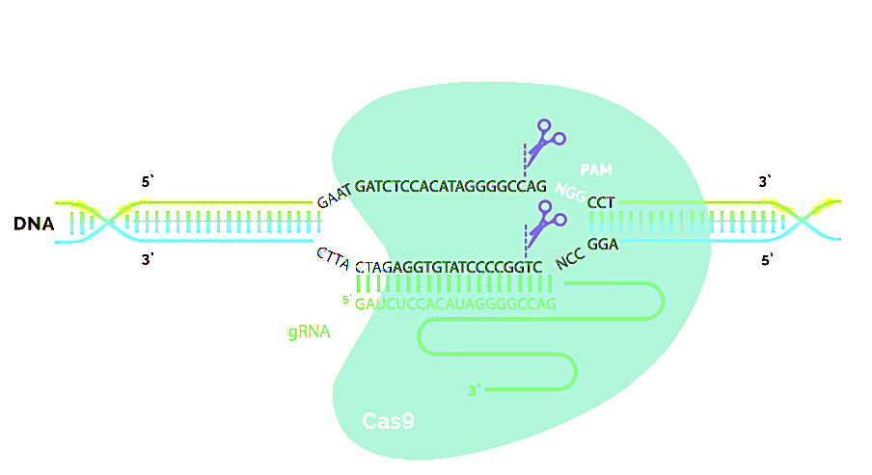
CRISPR-Cas9 System
The CRISPR-Cas9 system comprises a guide RNA (gRNA) and Cas9 nuclease, which together form a ribonucleoprotein (RNP) complex. The gRNA binds to the genomic target upstream of a protospacer adjacent motif (PAM), enabling the Cas9 nuclease to make a double-strand break in the DNA (denoted by the scissors). Adopted from: https://www.synthego.com/resources/crispr-101-ebook

Slide 33
You can also generate gRNA and Cas9 protein in test tubes and apply the two as ribonucleoprotein (RNP) complexes into the cells; this approach has recently been reported to be the most effective strategy (Liang et al. 2015). The complex is unstable and does not continue to function to cause additional off-target mutations.
Alteration of function through homologous recombination can also be accomplished through Crispr/Cas9 system.
Point or deletion mutations through Crispr/Cas9 is predictable. The only weakness is the mutations caused by the system in non-targeted genomic regions. There are many sequences similar to 16 bp target sequence in complex genome. Therefore, we have to investigate the genome sequence for target sequence just to make sure that the target site is either absent or is not present in coding sequences. One can always breed the desirable Crispr/Cas9-induced mutations through backcrossing.

Slide 34
Will There be a CRISPR Nobel Prize?
A CRISPR research project or experiment has not yet won a Nobel Prize, but given its popularity, it sure seems to be on the path to one. CRISPR is a novel DNA editing tool that is faster, more cost-efficient, and more accurate than any previous gene editing techniques. CRISPR has proven to be a powerful research tool contributing significantly to genetic research by allowing scientists to better understand biological processes associated with certain diseases. Given these significant breakthrough raises the obvious question: “Will there be a Nobel Prize for CRISPR research in the future?”
One thing is sure- if there were to be one, many CRISPR scientists, who played a vital role in the development of this technology, are strong contenders for the award. Listed below are some of the big names in CRISPR that would be the likely front runners for the prize.
Jennifer Doudna: The most celebrated name in CRISPR
Jennifer Doudna is one of the biggest names in CRISPR, as she is credited as the co-inventor of CRISPR. She was also the first to propose that enzymes from bacteria that control microbial immunity (CRISPR-Cas9) could be used for programmable editing of genomes. This is considered one of the most significant discoveries in recent history, as this technique is much faster and more accurate than any of the previous gene editing tools. Many people believe that Jennifer Doudna would be a top contender for a Nobel Prize for CRISPR.
Emmaneulle Charpentier: The co-founder of CRISPR
Emmanuelle Charpentier is the co-founder of CRISPR, along with Doudna. Charpentier first began biochemical characterization of CRISPR with her colleague in Vienna. She met Doudna in 2011, and they began working together soon after on what would go on to become one of the greatest inventions in the history of genetics.
Feng Zhang: The man who showed CRISPR could work in mammalian systems
Feng Zhang was the first to successfully adapt CRISPR-Cas9 for gene editing in eukaryotic cells. He further expanded his research beyond the technology itself to show how versatile it was, and demonstrated that it could be used in mammalian cells for the first time. His current focus is on developing tools that can be applied to study genetic diseases, and develop diagnostics and therapeutics. His team was also the first to show CRISPR systems that can target RNA.
Virginijus Šikšnys: The overshadowed independent CRISPR inventor
Virginijus Šikšnys was also one of the first researchers to show how CRISPR works. Šikšnys is biochemist from Lithuania who independently figured out how certain bacteria are able to cut and paste specific genes from other organisms. He and his colleagues also found a way to control the process.
Luck played a huge role in his research not getting as much attention as Doudna’s did. The paper he submitted to Cell in April 2012 was rejected, while Doudna’s paper was published in Science two months later, fetching her celebrity status in the CRISPR field.

Slide 35
Establishing a CRISPR–Cas-like immune system conferring DNA virus resistance in plants
Ji et al. 2015

Slide 36
CRISPR/Cas9-mediated viral interference in plants
Ali et al. 2015

Slide 38
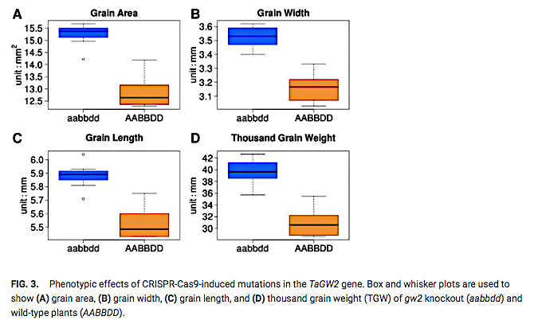
The knockout mutations in all three homoeologous copies of one of the target genes, TaGW2, resulted in a substantial increase in seed size and thousand grain weight.
Wang et al. 2018

Slide 39
Lecture 5: Engineering Traits (February 12)
Cross Protection
Gene Silencing
Host-induced Gene Silencing
Gene Editing
Overexpression of Genes

Slide 40
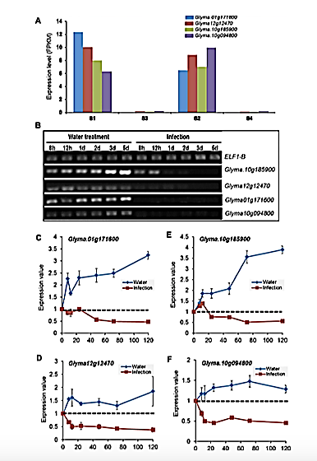
Only four classes of soybean genes are suppressed by Fusarium virguliforme that causes sudden death syndrome (SDS) in soybean.
Ngaki et al. 2016

Slide 41
Overexpression of GmARP1 enhances SDS resistance in transgenic soybean plants.
Ngaki et al. 2016

Slide 42
Overexpression of GmDS1 gene led to generation of broad-spectrum disease and pest resistance.
Ngaki et al. 2020; under review

Slide 43
Overexpression of GmDS1 conferred immunity of transgenic soybean plants against the spider mites.

Slide 44
Overexpression of GmDS1 conferred immunity of transgenic soybean plants against the soybean aphids.

Slide 45
Overexpression of GmDS1 conferred immunity of transgenic soybean plants against the soybean cyst nematode.

Slide 46
Regulation of defense-related genes 12 h following treatment with chitin
Overexpression of GmDS1: A novel trait

Slide 47
Questions?

